Slide 1
Restaurant Point of Sale (POS)
Developer: Piyawat & Vichaphol

Slide 2
Why choose RestaurantPOS?
Wanted to develop from the old one from last semester, with all knowledge studied in this OOP.
Challenging and a good time to improve coding skills.

Slide 3
Server and Database used in the program
Google Cloud Platform is use to open our server using MySQL database.
Free for Gmail users one year (300 dollars).

Slide 4
Interesting Technology
jBCrypt - strong password hashing for java.
Map<K,V> - Keys are Menu object, Values are Integer.

Slide 5
Patterns
Model-View-Controller pattern
Observer pattern
Singleton pattern

Slide 6
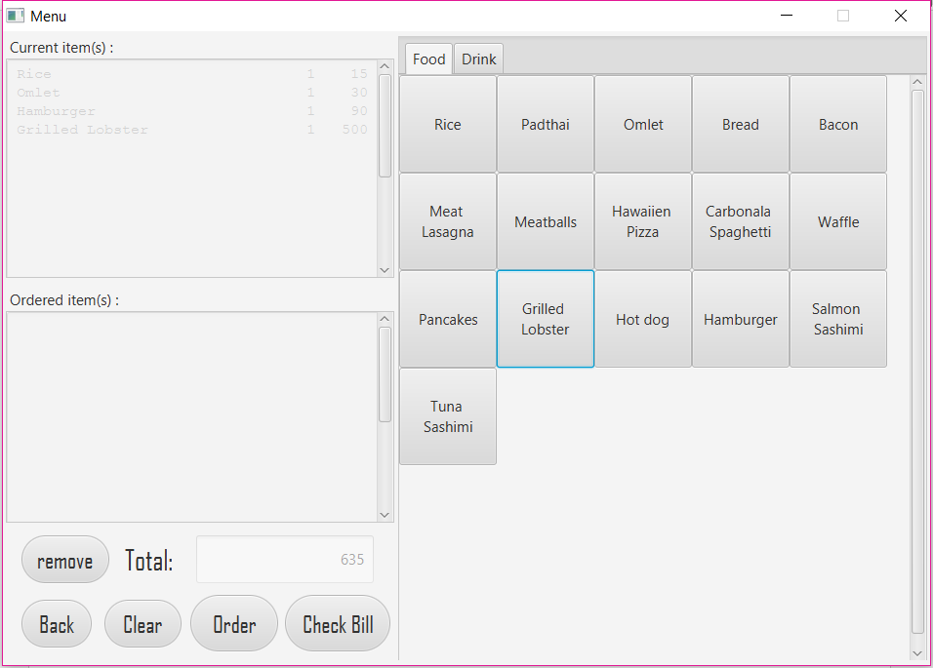
Model View Controller (MVC)
Model

Slide 7
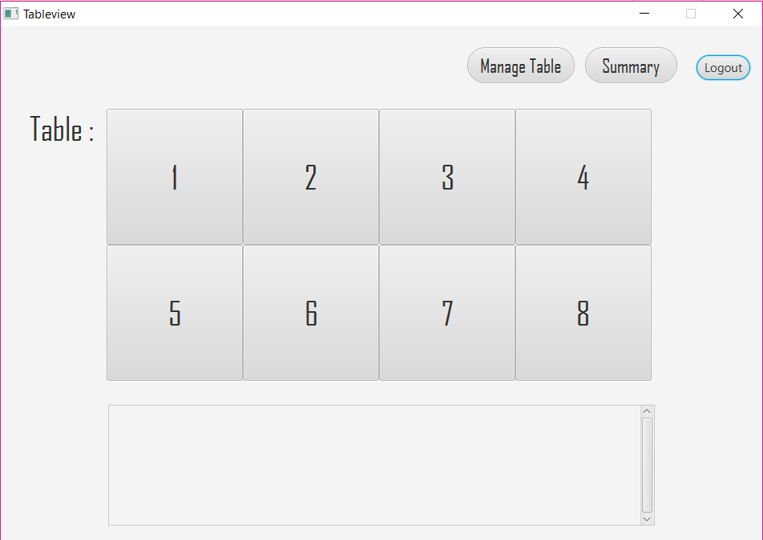
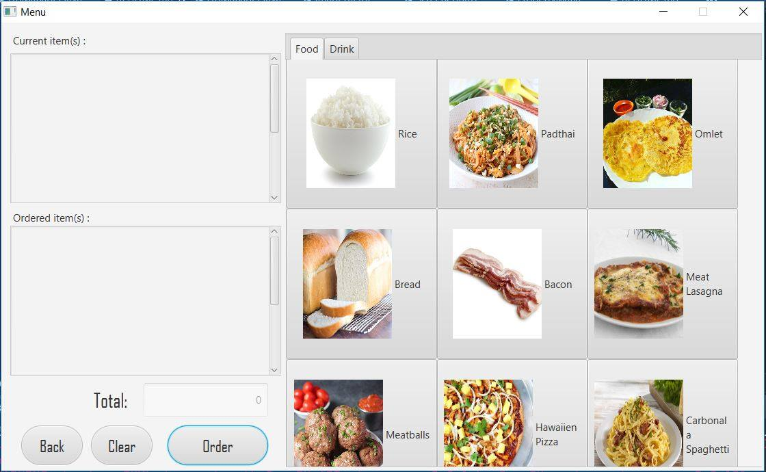
Obeserver pattern
setChanged();
notifyObserver();
Observable
update();
Observer
(On different computers)

Slide 8
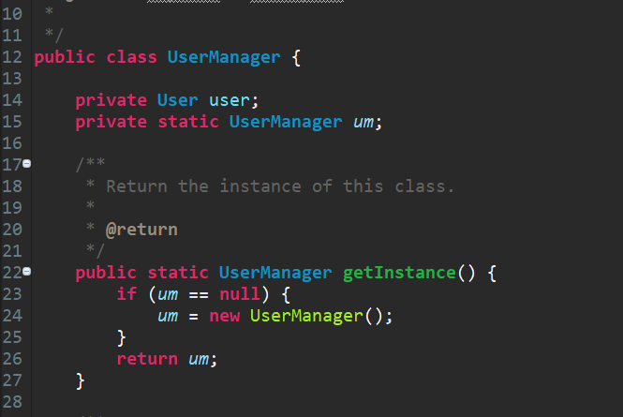
Singleton pattern
Instance of this class
Static accessor for instance

Slide 9
Program Demonstration

